Slide 1
Machine Learning DSECL ZG565
Dr. Monali Mavani

Slide 2
Session Content
Estimating Parameters Logistic Regression Bayesian approach (New chapter Tom Mitchell)
Estimating Parameters Linear Regression closed form solution (Andrew Ng notes)
Bayesian linear regression (6.4 Tom Mitchell)
Linear basis function models (3.1 Bishop)
Over fitting, Under fitting, Regularization (1.1 Bishop, Andrew Ng notes)

Slide 3
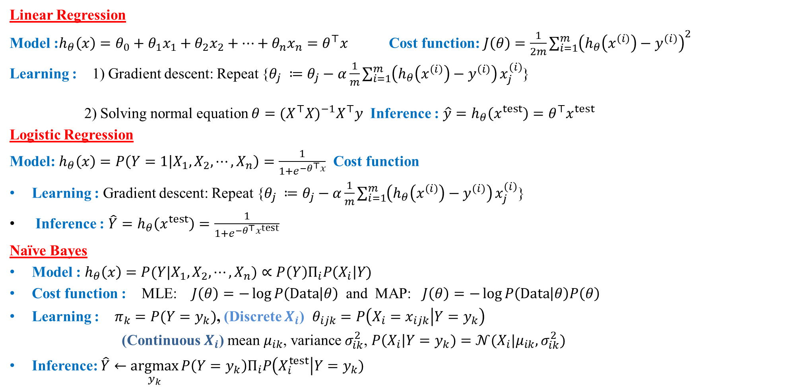
Recall………..
Linear Regression
Model :$h_{θ}\left(x\right)=θ_{0}+θ_{1}x_{1}+θ_{2}x_{2}+…+θ_{n}x_{n}=θ^{⊤}x$ Cost function: $J\left(θ\right)=\frac{1}{2m}\sum_{i=1}^{m}{{\left(h_{θ}\left(x^{\left(i\right)}\right)−y^{\left(i\right)}\right)}^{2}}$
Learning : 1) Gradient descent: Repeat {$θ_{j} ≔θ_{j}−α\frac{1}{m}\sum_{i=1}^{m}{\left(h_{θ}\left(x^{\left(i\right)}\right)−y^{\left(i\right)}\right)}x_{j}^{\left(i\right)}$}
2) Solving normal equation $θ={(X^{⊤}X)}^{−1}X^{⊤}y$ Inference : $\hat{y}=h_{θ}\left(x^{test}\right)=θ^{⊤}x^{test}$
Logistic Regression
Model: $h_{θ}\left(x\right)=P\left(Y=1 | X_{1},X_{2}, ⋯, X_{n}\right)=\frac{1}{1+e^{−θ^{⊤}x}}$ Cost function
Learning : Gradient descent: Repeat {$θ_{j} ≔θ_{j}−α\frac{1}{m}\sum_{i=1}^{m}{\left(h_{θ}\left(x^{\left(i\right)}\right)−y^{\left(i\right)}\right)}x_{j}^{\left(i\right)}$}
Inference : $\hat{Y}=h_{θ}\left(x^{test}\right)=\frac{1}{1+e^{−θ^{⊤}x^{test}}}$
Naïve Bayes
Model :$h_{θ}\left(x\right)=P(Y|X_{1},X_{2}, ⋯, X_{n})∝P\left(Y\right)Π_{i}P\left(X_{i}\right|Y)$
Cost function : MLE: $J\left(θ\right)=−\log{P\left(Data | θ\right)}$ and MAP: $J\left(θ\right)=−\log{P\left(Data | θ\right)P\left(θ\right)}$
Learning : $π_{k}=P(Y=y_{k})$, (Discrete $X_{i}$) $θ_{ijk}=P\left(X_{i}=x_{ijk} | Y=y_{k}\right)$
(Continuous $X_{i}$) mean $μ_{ik}$, variance $σ_{ik}^{2}$, $P\left(X_{i}\right|Y=y_{k})=𝒩(X_{i}|μ_{ik},σ_{ik}^{2})$
Inference: $\hat{Y}←\underset{y_{k}}{argmax}{P\left(Y=y_{k}\right)Π_{i}P\left(X_{i}^{test}\right|Y=y_{k})}$

Slide 4
Estimating Parameters - Learning Logistic Regression
Estimation of n+1 parameters say, θ = (θ₀, θ₁ ,……., θ_{n} )for which
the probability of the observed data is the maximum on the training data set.
generative learning
the Gaussian Naive Bayes assumptions
discriminative learning
maximize the conditional data likelihood ( or minimizing negative likelihood)
Uses gradient descent optimization

Slide 5
Generative learning Logistic Regression - the Gaussian Naive Bayes assumptions

Slide 6
Logistic Regression –Bayesian Analysis (Parameter Estimation : GNB assumption)
Consider learning f: X →Y, where
X is a vector of real-valued features, < X₁ … X_{n} >
Y is boolean (binary logistic regression)
In general, Y is a discrete attribute and it can take k ≥ 2 different values.
assume all X_{i} are conditionally independent given Y.
model P(X_{i} | Y=y_{k}) as Gaussian
model P(Y) as Bernoulli (π): summation of all possible probabilities is 1.
P(Y=1) = π P(Y=0) = 1-π
In addition, assume variance is independent of class, i.e. σ_{i0} = σ_{i1} = σ_{i}
What do these assumptions imply about the form of P(Y|X)?

Slide 7
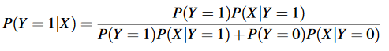
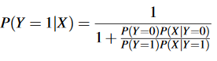
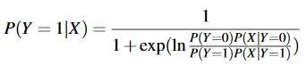
Logistic Regression –Bayesian Analysis
divide numerator and denumerator with same term

Slide 8
Logistic Regression –Bayesian Analysis
By independence assumption:
P(Y=1)=π and P(Y=0)=1-π by modelling P(Y) as Bernoulli

Slide 9
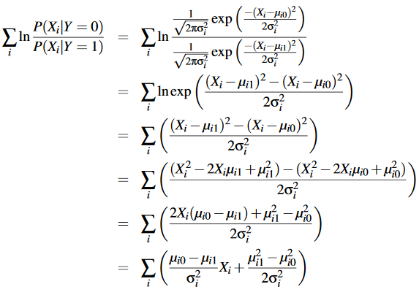
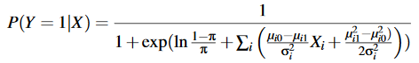
Logistic Regression –Bayesian Analysis

Slide 10
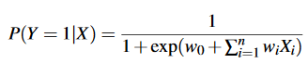
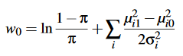
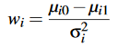
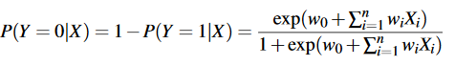
Logistic Regression –Bayesian Analysis
P(YjX) in the parametric form
linear classification rule

Slide 11
Logistic Regression for More Than 2 Classes
In general case of logistic regression, we have M classes and Y∊{y₁,…,y_{M}}
for k = M

Slide 12
Multi-class classification
Email foldering/tagging: Work, Friends, Family, Hobby
Medical diagrams: Not ill, Cold, Flu
Weather: Sunny, Cloudy, Rain, Snow

Slide 13
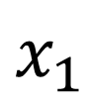
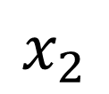
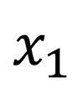
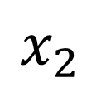
Multi-class classification
Binary classification
Multiclass classification
$$x_{2}$$
$$x_{2}$$
$$x_{1}$$
$$x_{1}$$

Slide 14
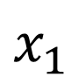
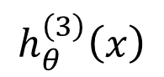
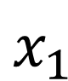
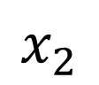
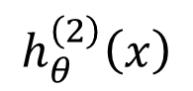
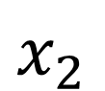
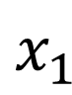
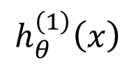
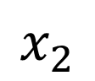
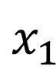
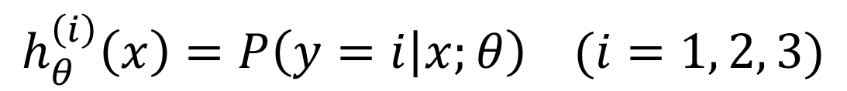
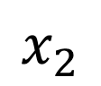
One-vs-all (one-vs-rest)
$$x_{2}$$
$$h_{θ}^{\left(1\right)}\left(x\right)$$
$$x_{1}$$
$$x_{2}$$
$$x_{2}$$
$$h_{θ}^{\left(2\right)}\left(x\right)$$
$$x_{1}$$
$$x_{1}$$
Class 1:
Class 2:
Class 3:
$$h_{θ}^{\left(3\right)}\left(x\right)$$
$$x_{2}$$
$$h_{θ}^{\left(i\right)}\left(x\right)=P\left(y=i | x;θ\right) (i=1, 2, 3)$$
$$x_{1}$$

Slide 15
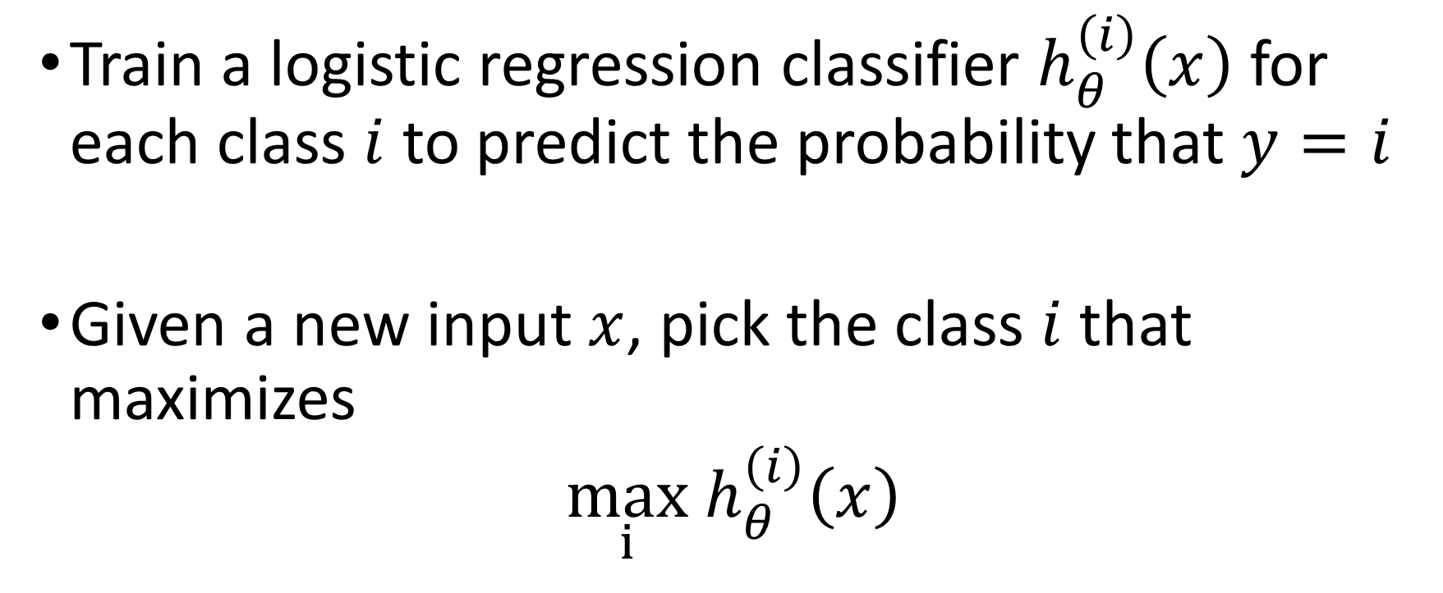
One-vs-all
Train a logistic regression classifier $h_{θ}^{\left(i\right)}\left(x\right)$ for each class $i$ to predict the probability that $y=i$
Given a new input $x$, pick the class $i$that maximizes
$\max_{i}$ $h_{θ}^{\left(i\right)}\left(x\right)$

Slide 16
Discriminative Approach - Maximum conditional likelihood estimate (MCLE)

Slide 17
Parameter estimation of generic logistic regression
Logistic Regression holds in many problem settings beyond the GNB problem
General method required for estimating it in a more broad range of cases.
In many cases we may suspect the GNB assumptions are not perfectly satisﬁed.
We may wish to estimate the wi parameters directly from the data

Slide 18
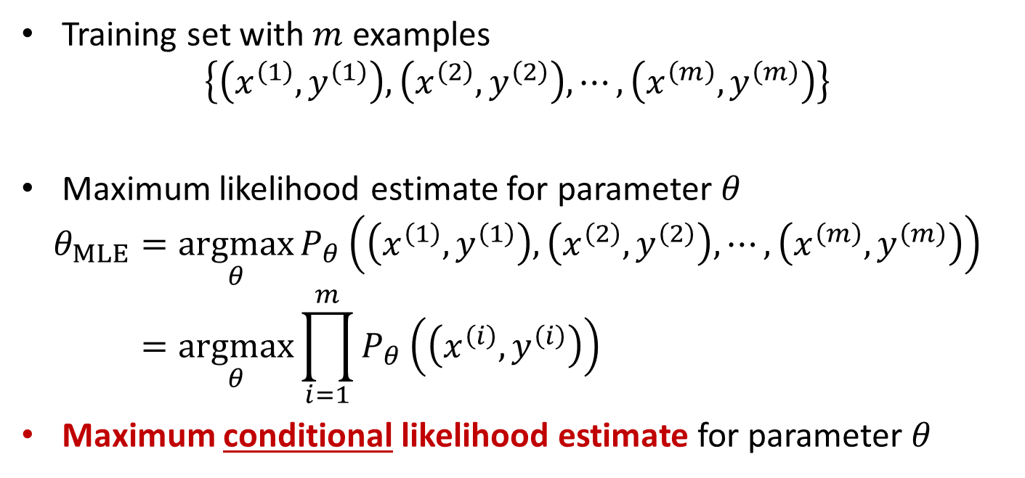
Discriminative Approach - Data conditional likelihood
Training set with $m$ examples
$$\left\{\left(x^{\left(1\right)}, y^{\left(1\right)}\right), \left(x^{\left(2\right)}, y^{\left(2\right)}\right), ⋯,\left(x^{\left(m\right)}, y^{\left(m\right)}\right)\right\}$$
Maximum likelihood estimate for parameter $θ$
$$θ_{MLE}=\underset{θ}{argmax}{P_{θ}\left(\left(x^{\left(1\right)}, y^{\left(1\right)}\right), \left(x^{\left(2\right)}, y^{\left(2\right)}\right), ⋯,\left(x^{\left(m\right)}, y^{\left(m\right)}\right)\right)} \\ =\underset{θ}{argmax}{\prod_{i=1}^{m}{P_{θ}\left(\left(x^{\left(i\right)}, y^{\left(i\right)}\right)\right)}}$$
Maximum conditional likelihood estimate for parameter $θ$

Slide 19

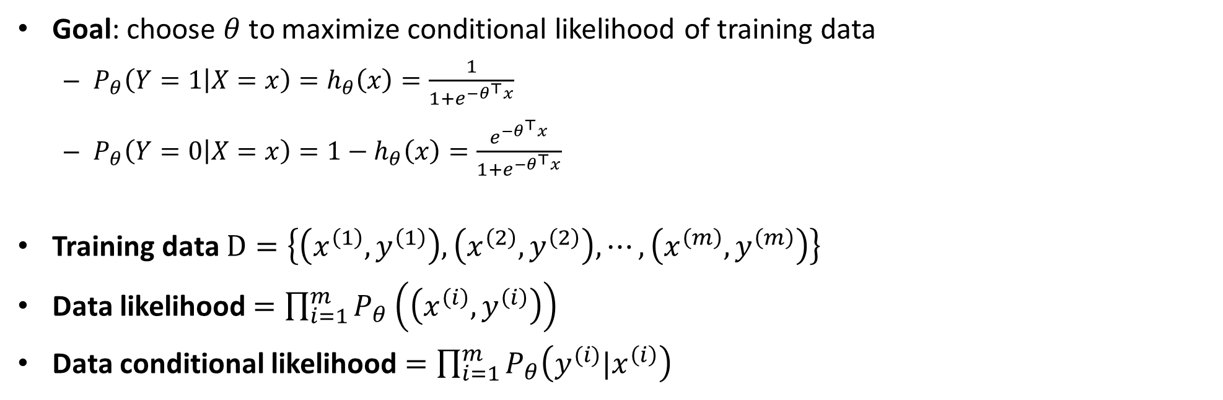
Goal: choose $θ$to maximize conditional likelihood of training data
$P_{θ}\left(Y=1 | X=x\right)=h_{θ}\left(x\right)=\frac{1}{1+e^{{−θ}^{⊤}x}}$
$P_{θ}\left(Y=0 | X=x\right)=1−h_{θ}\left(x\right)=\frac{e^{{−θ}^{⊤}x}}{1+e^{{−θ}^{⊤}x}}$
Training data $D=\left\{\left(x^{\left(1\right)}, y^{\left(1\right)}\right), \left(x^{\left(2\right)}, y^{\left(2\right)}\right), ⋯,\left(x^{\left(m\right)}, y^{\left(m\right)}\right)\right\}$
Data likelihood $=\prod_{i=1}^{m}{P_{θ}\left(\left(x^{\left(i\right)}, y^{\left(i\right)}\right)\right)}$
Data conditional likelihood $=\prod_{i=1}^{m}{P_{θ}\left(y^{(i)}|x^{\left(i\right)}\right)}$
$θ_{MCLE}=\underset{θ}{argmax}$ $\prod_{i=1}^{m}{P_{θ}\left(y^{(i)}|x^{\left(i\right)}\right)}$

Slide 21
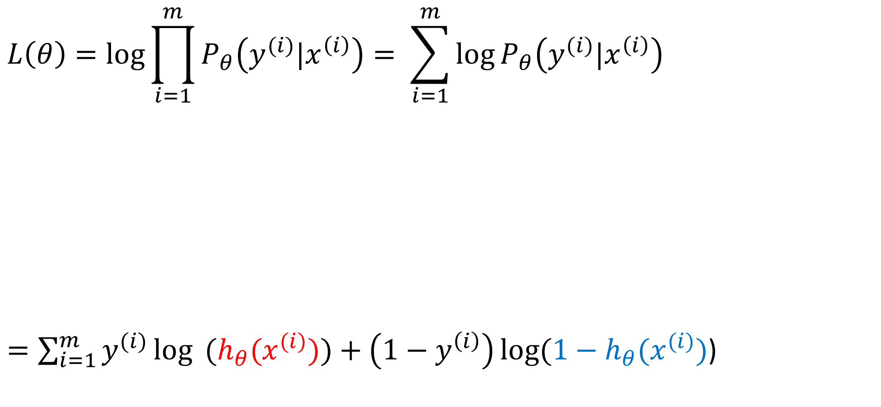
Expressing conditional log-likelihood
$$L\left(θ\right)=\log{\prod_{i=1}^{m}{P_{θ}\left(y^{(i)}|x^{\left(i\right)}\right)}}= \sum_{i=1}^{m}{\log{P_{θ}\left(y^{(i)}|x^{\left(i\right)}\right)}}$$
$=\sum_{i=1}^{m}{y^{(i)}\log{ (h_{θ}(x^{(i)})})}+\left(1−y^{\left(i\right)}\right)\log{(1−h_{θ}(x^{(i)})}$)

Slide 22
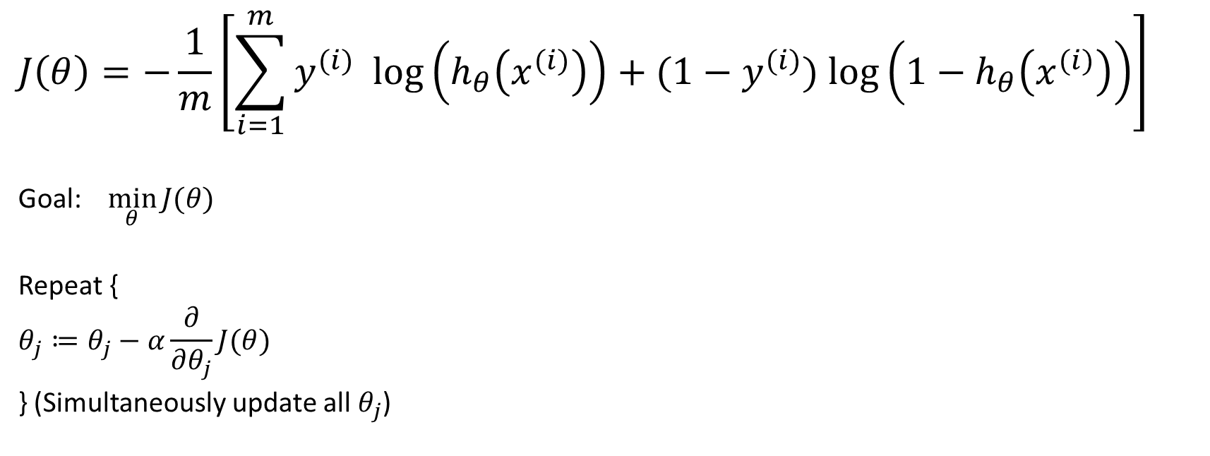
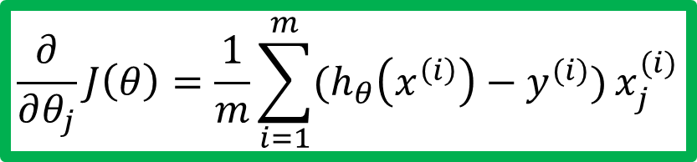
Gradient descent
$$J\left(θ\right)=−\frac{1}{m}\left[\sum_{i=1}^{m}{y^{(i)} log\left(h_{θ}\left(x^{(i)}\right)\right)+(1−y^{(i)}) log\left({1−h}_{θ}\left(x^{(i)}\right)\right)}\right]$$
Goal: $\min_{θ}{J(θ)}$
Repeat {
$$θ_{j}≔θ_{j}−α\frac{∂}{∂θ_{j}}J(θ)$$
} (Simultaneously update all $θ_{j}$)
Good news: Convex function!
Bad news: No analytical solution
$$\frac{∂}{∂θ_{j}}J\left(θ\right)=\frac{1}{m}\sum_{i=1}^{m}{(h_{θ}\left(x^{\left(i\right)}\right)−y^{(i)})}x_{j}^{(i)}$$

Slide 23
Estimating Parameters for Linear Regression
Geometric approach
Gradient Descent (Done in session 5)
Closed form solution
Bayesian approach
Using Maximum Likelihood Estimation (Done in session 3)

Slide 24
Learning Model Parameters – Closed Form Solution (using vectorization)

Slide 25
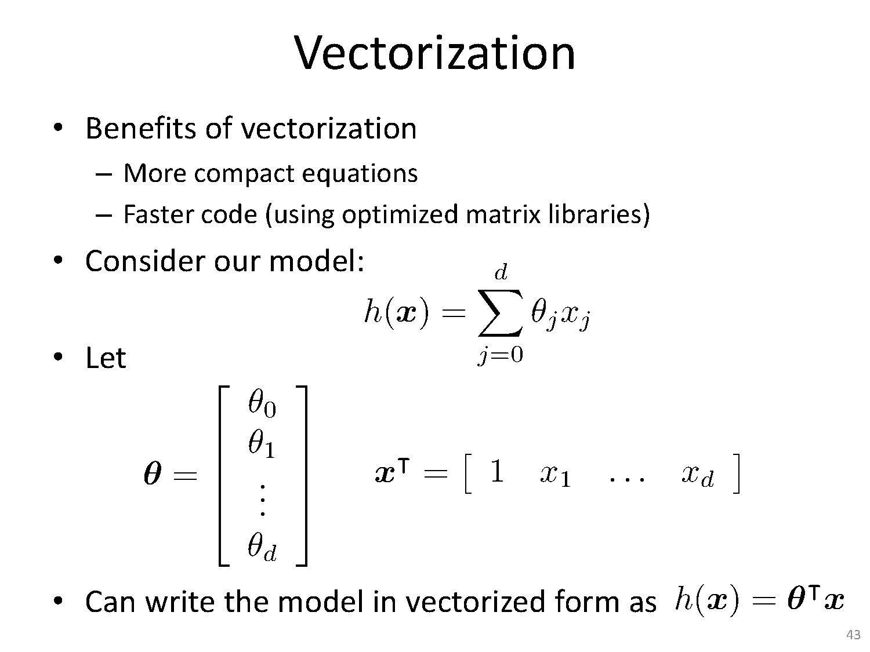

Slide 26
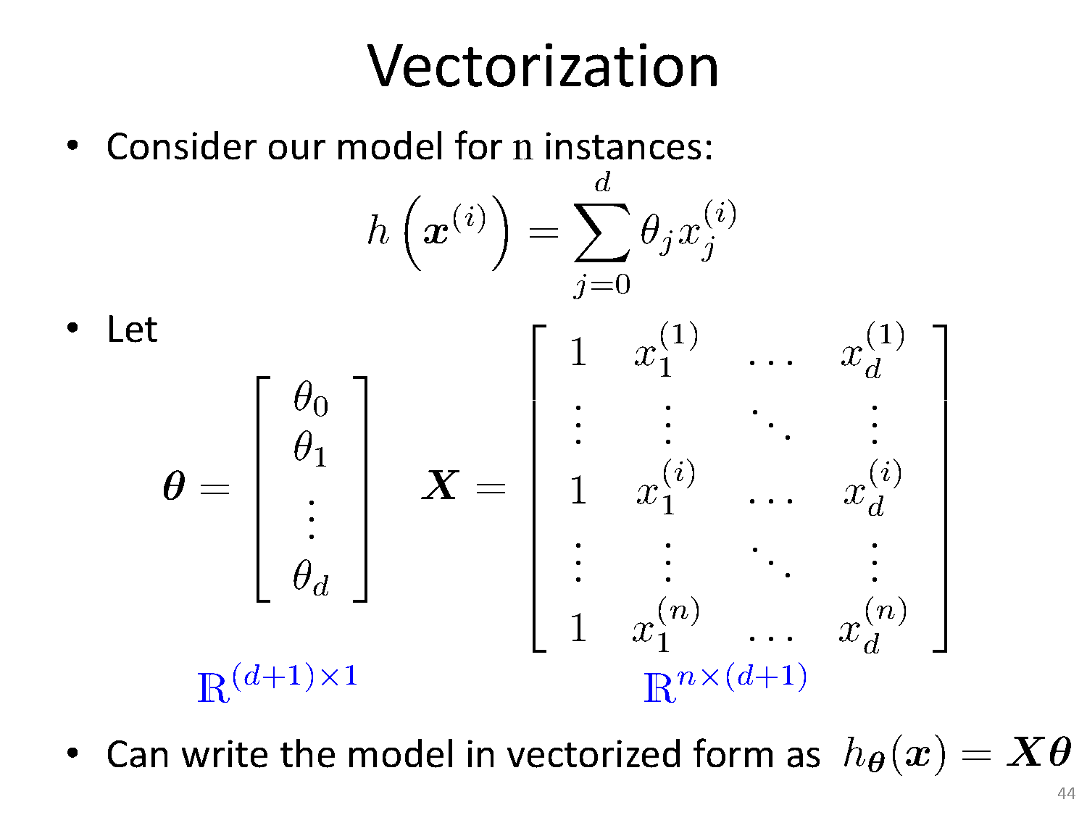

Slide 27
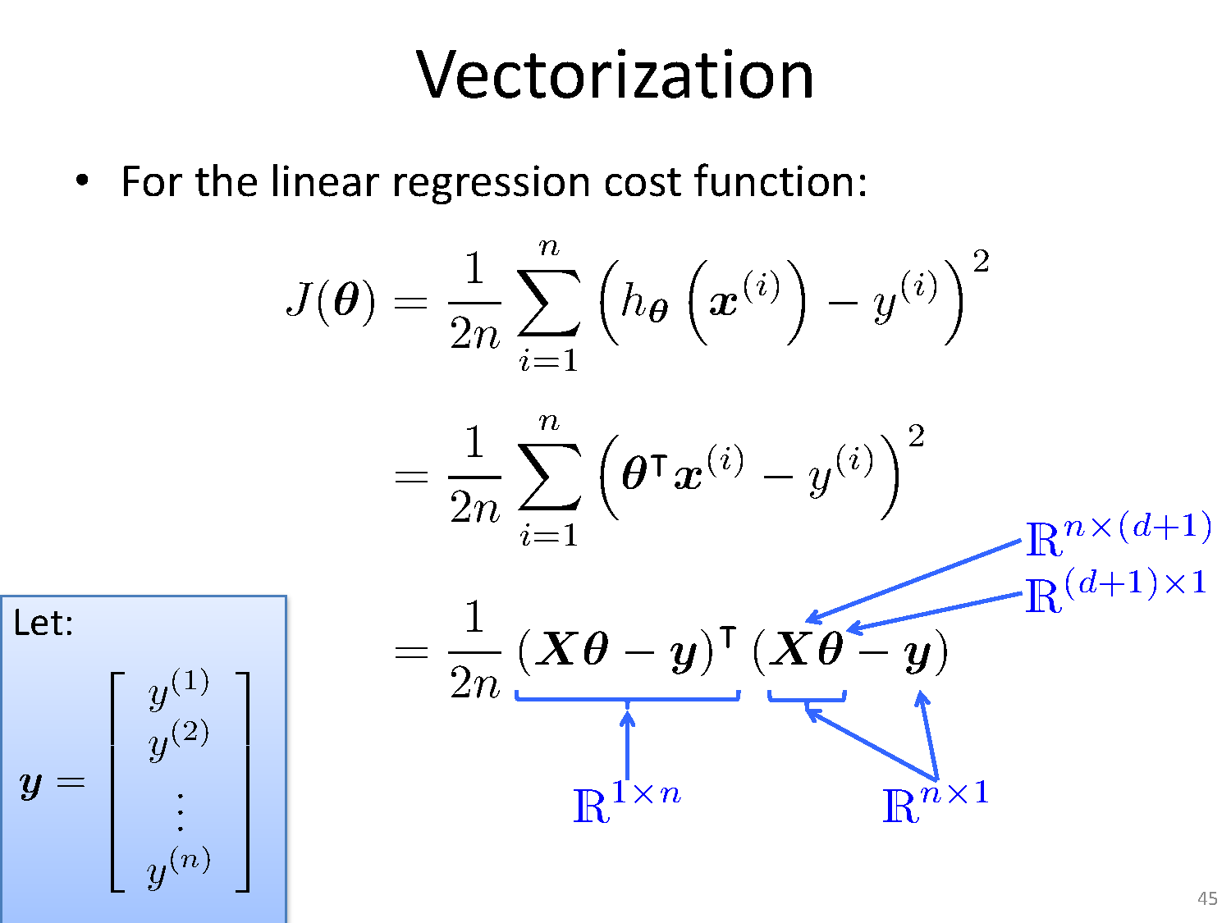

Slide 28
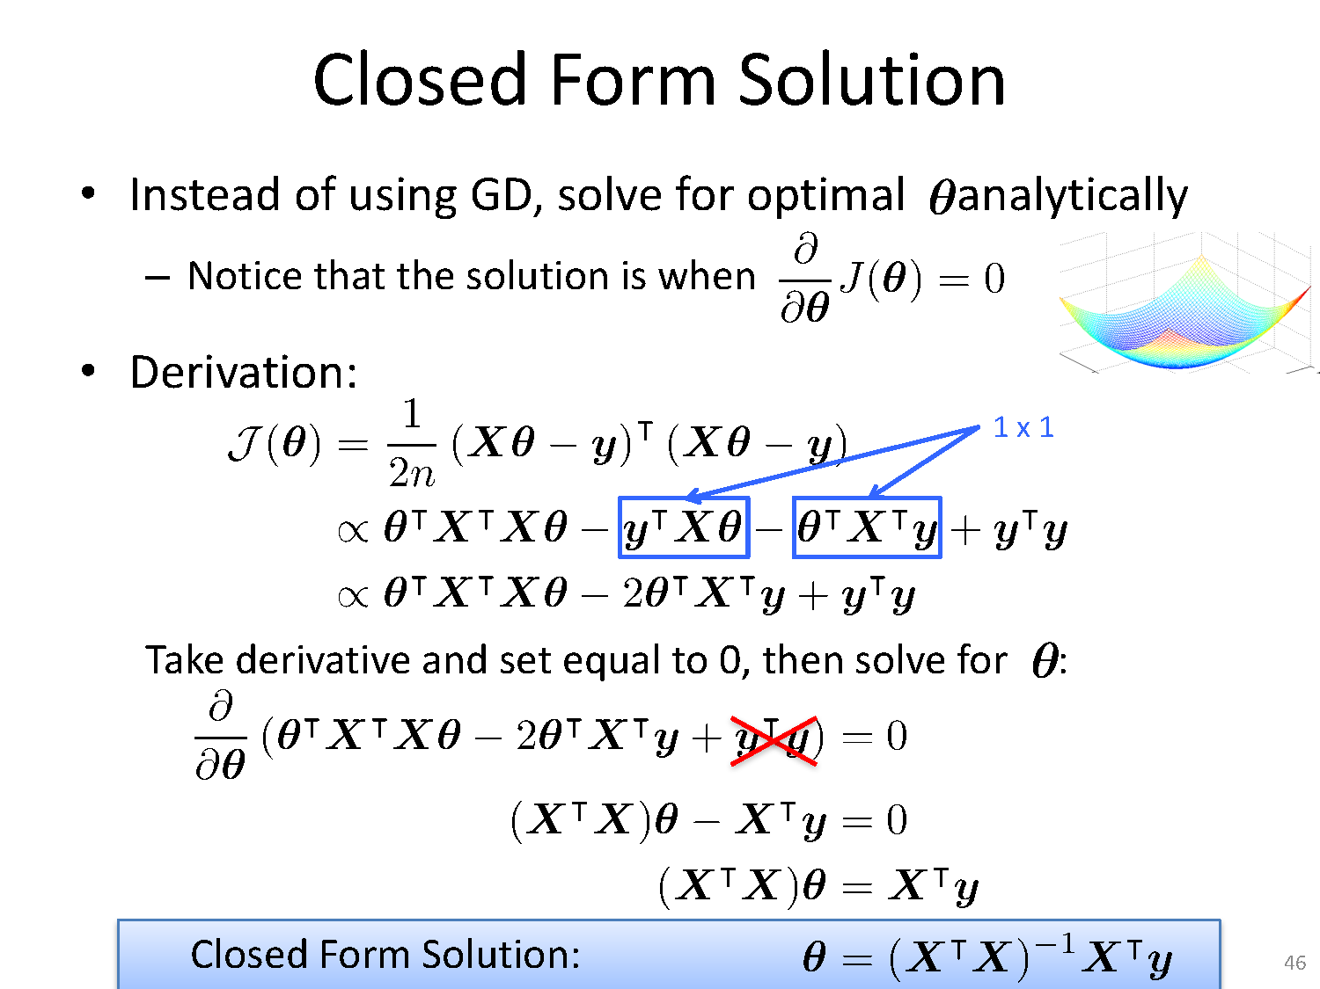

Slide 29
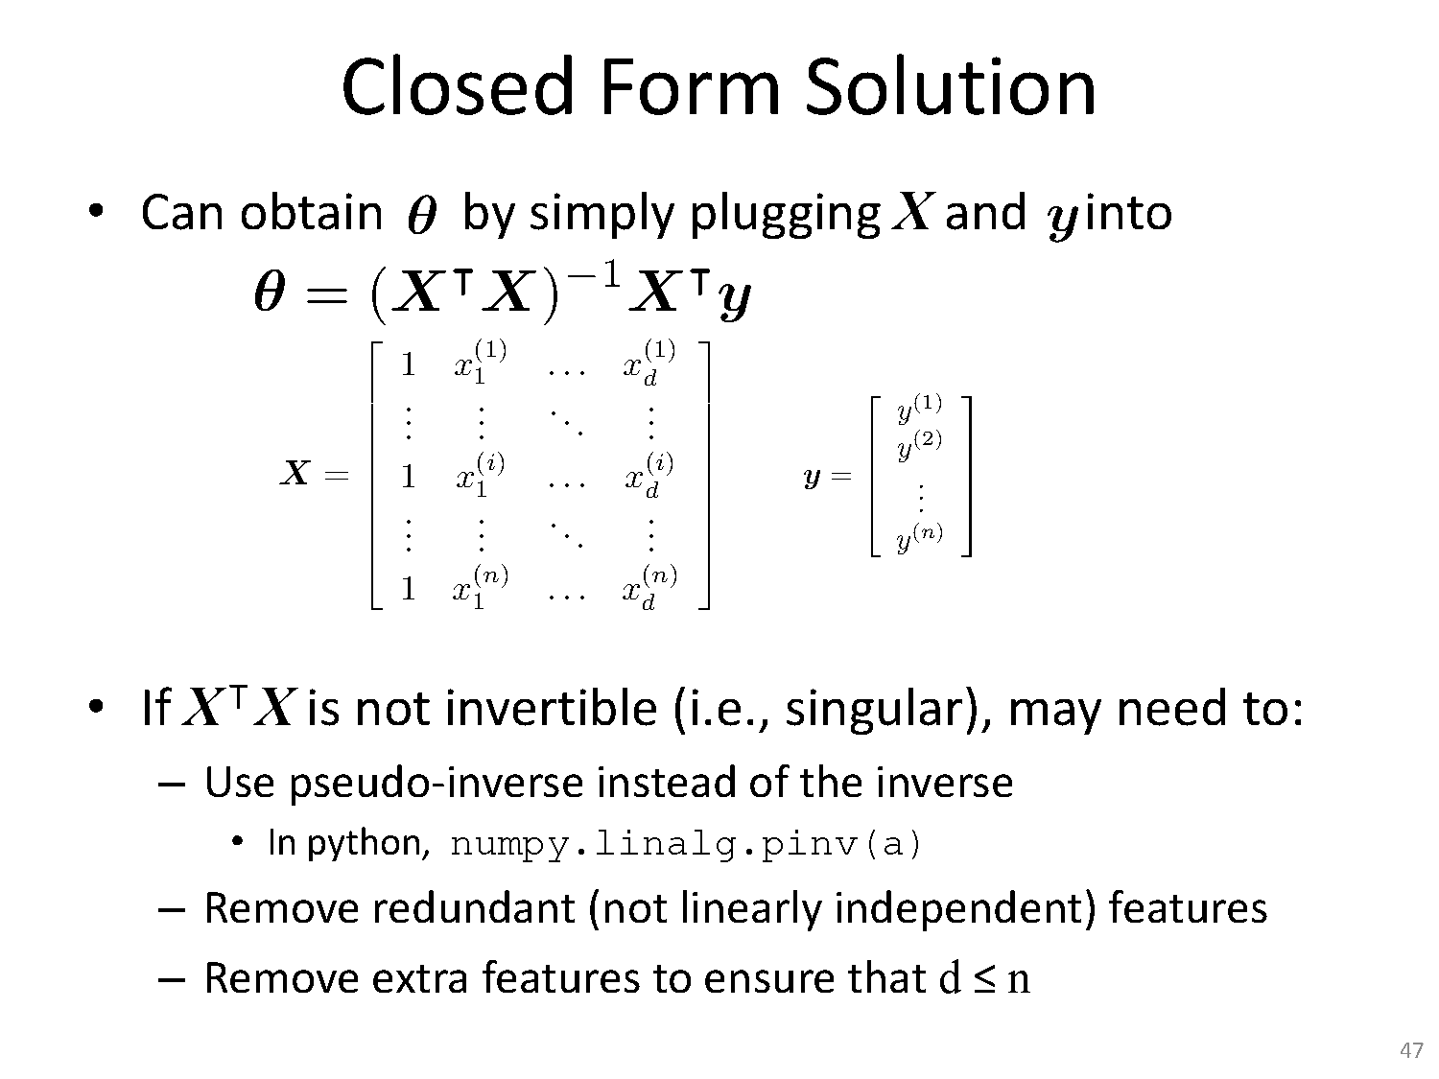

Slide 30
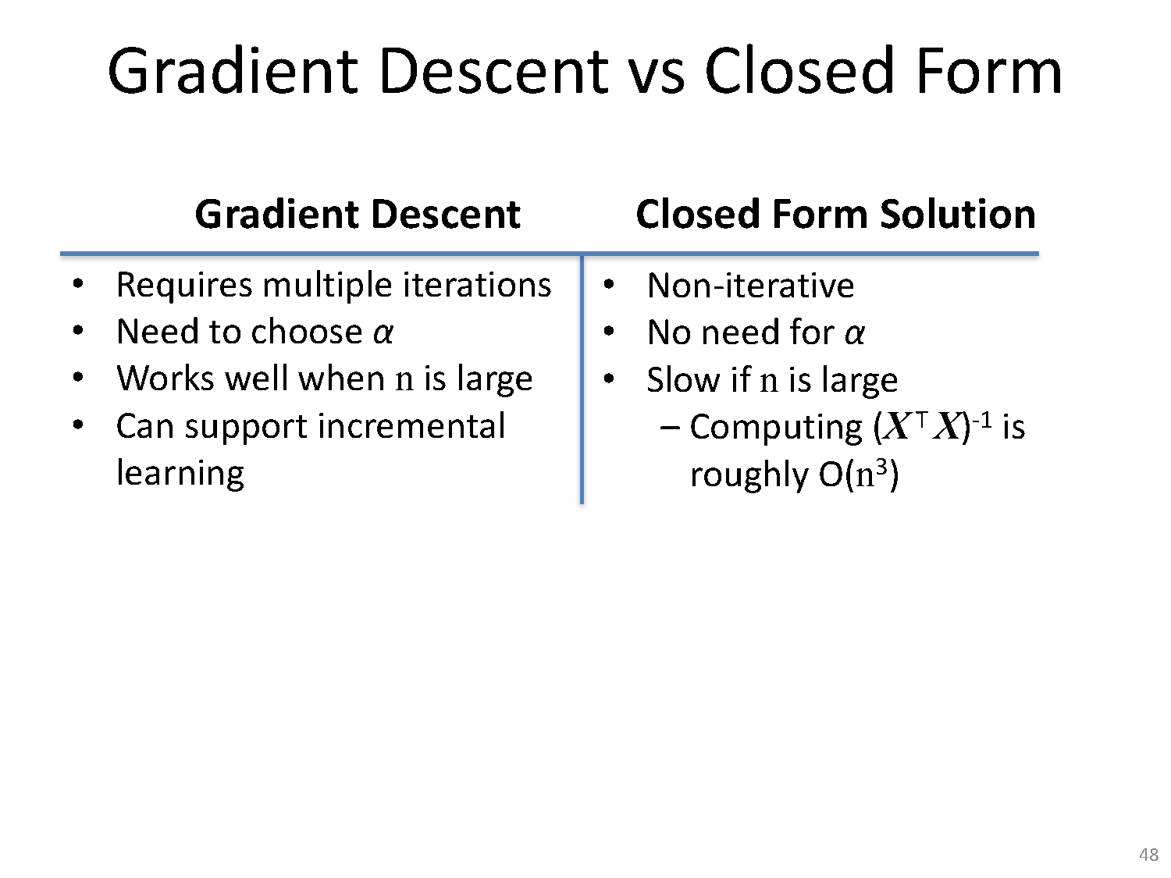

Slide 31
Linear Basis Function Models

Slide 32
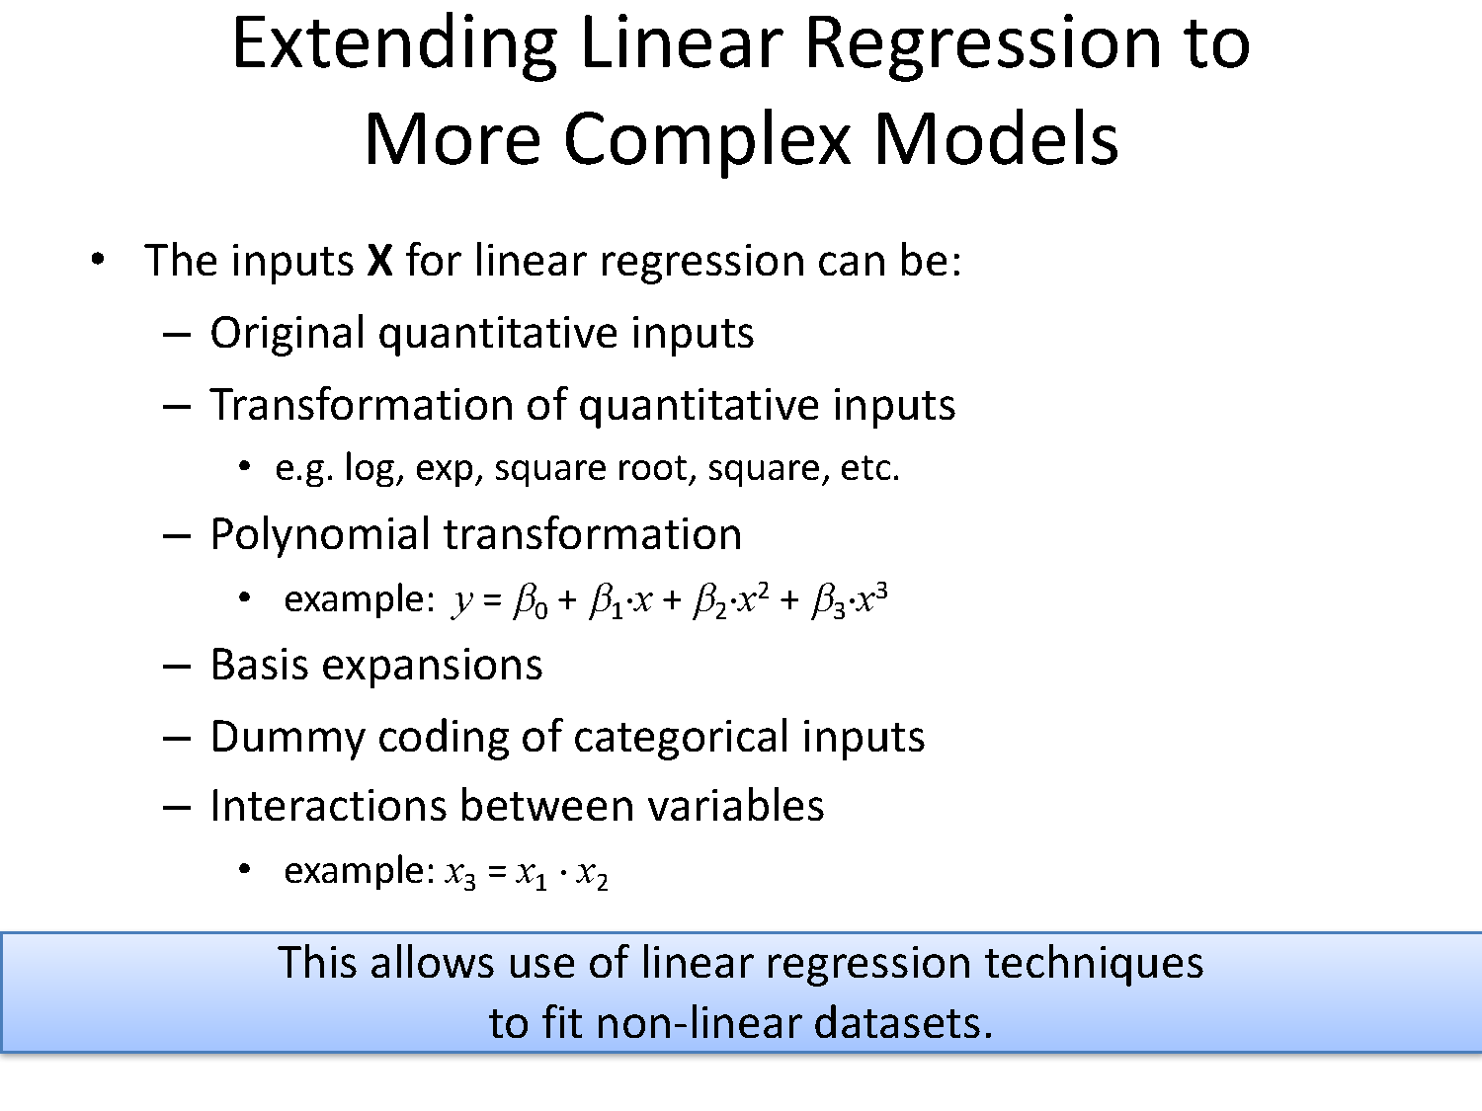

Slide 33
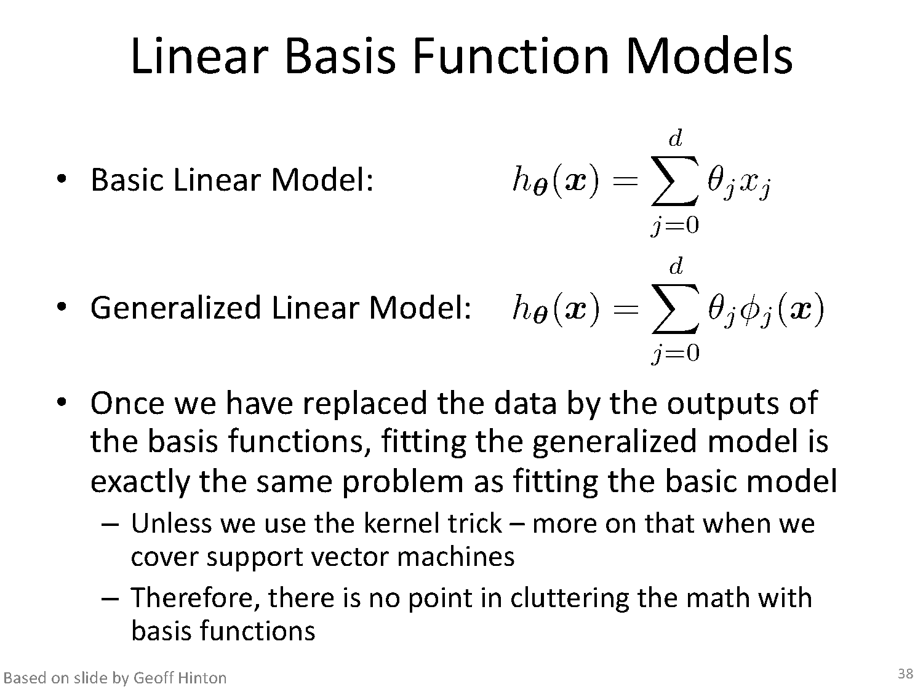
Notes:
By using nonlinear basis functions, we allow the function y(x,w) to be a nonlinear function of the input vector x. Functions of the form (3.2) are called linear models, however, because this function is linear in w. It is this

Slide 34
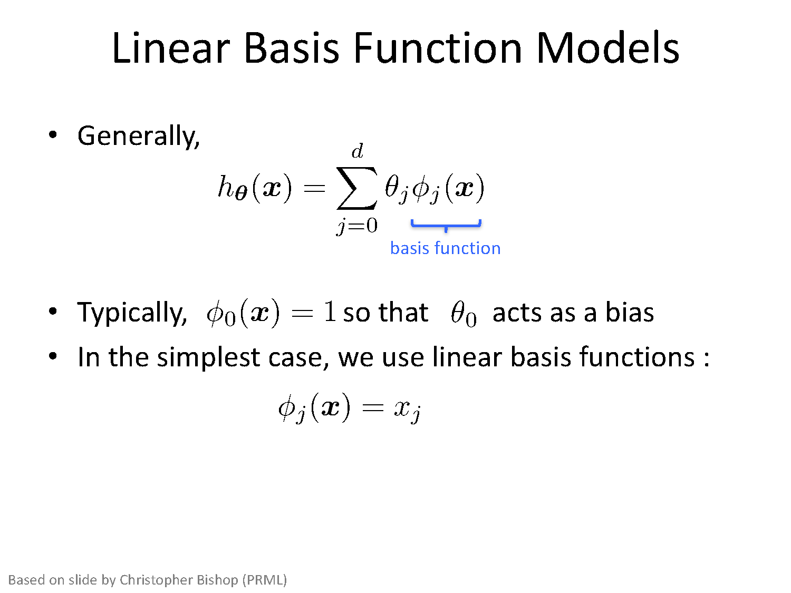

Slide 35
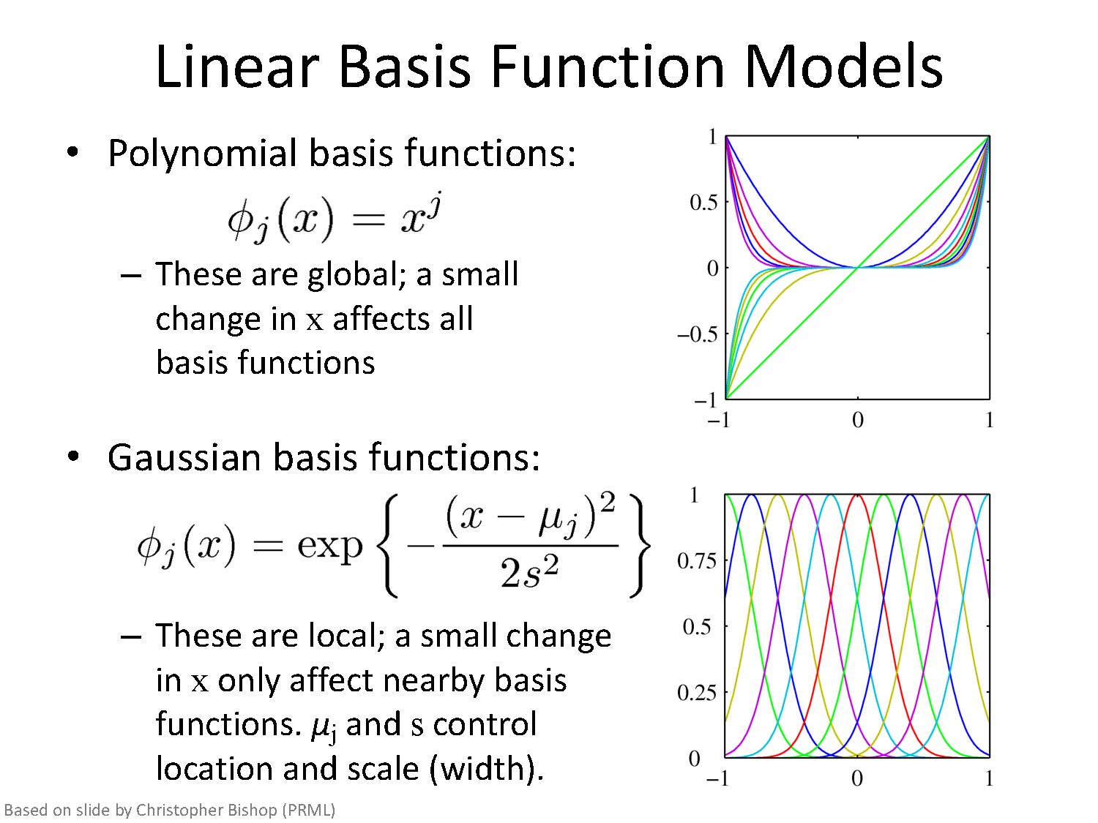

Slide 36
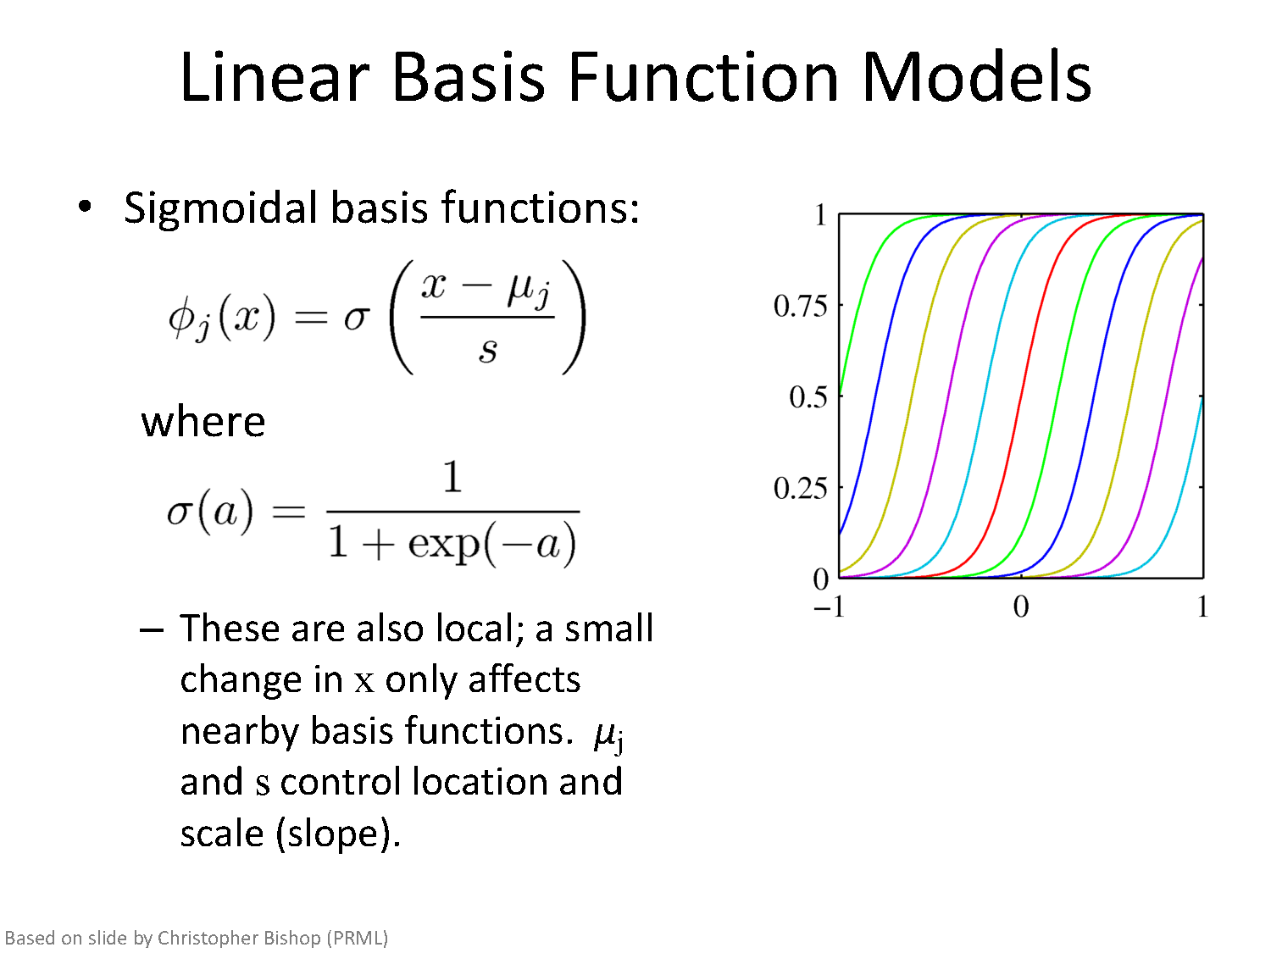
By using nonlinear basis functions, we allow the function y(x,w) to be a nonlinear function of the input vector x. They are called linear models because this function is linear in w. It is this

Slide 37
Over fitting, Under fitting, Regularization

Slide 38
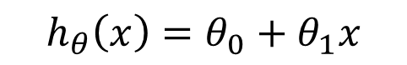
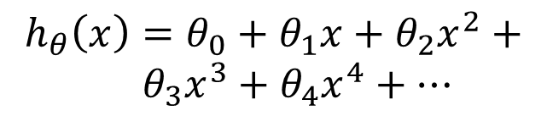
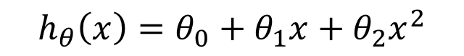
Linear regression
Price ($) in 1000’s
Price ($) in 1000’s
Price ($) in 1000’s
Size in feet^2
Size in feet^2
Size in feet^2
$$h_{θ}\left(x\right)=θ_{0}+θ_{1}x$$
$$h_{θ}\left(x\right)=θ_{0}+θ_{1}x+θ_{2}x^{2}$$
$$h_{θ}\left(x\right)=θ_{0}+θ_{1}x+θ_{2}x^{2}+ \\ { θ}_{3}x^{3}+θ_{4}x^{4}+⋯$$
Underfitting
Just right
Overfitting
High bias
High variance

Slide 39
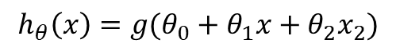
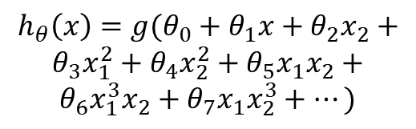
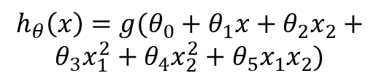
Logistic regression
Age
Age
Age
Tumor Size
Tumor Size
Tumor Size
$$h_{θ}\left(x\right)={g(θ}_{0}+θ_{1}x+θ_{2}x_{2})$$
$$h_{θ}\left(x\right)={g(θ}_{0}+θ_{1}x+θ_{2}x_{2}+$$
$$θ_{3}x_{1}^{2}+θ_{4}x_{2}^{2}+θ_{5}x_{1}x_{2})$$
$$h_{θ}\left(x\right)={g(θ}_{0}+θ_{1}x+θ_{2}x_{2}+$$
$$θ_{3}x_{1}^{2}+θ_{4}x_{2}^{2}+θ_{5}x_{1}x_{2}+$$
$$θ_{6}x_{1}^{3}x_{2}+θ_{7}x_{1}x_{2}^{3}+⋯)$$
Underfitting
Overfitting

Slide 40
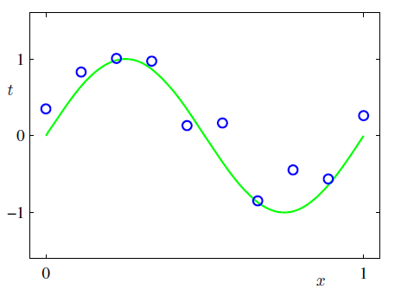
Example: Curve fitting problem
F(x) = sin(2Пx) + noise (Gaussian)

Slide 41


Curve fitting problem
Problem: We shall fit the data using a polynomial function of the form.
Linear model: It is linear in unknown parameter w
The values of the coefficients will be determined by fitting the polynomial to the training data.
By minimizing error function

Slide 42

Curve fitting problem: Model Selection

Slide 43


Model Selection
Goal is to achieve good generalization.
Generalization performance can be evaluated using test data set.
It is sometimes more convenient to use the root-mean-square.

Slide 44

Coefficients for polynomials of various order

Slide 45

Size of the data set reduces the over-fitting problem

Slide 46
Size of the data set reduces the over-fitting problem
One rough heuristic says that data points should be multiple (5 to 10) adaptive parameter.
This limitation seems little disappointing as it seems more reasonable to take number of parameters according to the problem complexity rather that given data points.
Any Solution?
Regularization

Slide 47


Slide 48

Regularization
Modified error function:
Coefficients without regularization

Slide 49

Regularization
Table of the coefficients w for M =9 polynomials with various values for the regularization parameter λ
λ = 0
λ ≈0.000000009
λ = 1

Slide 50
Regularization

Slide 51

Regularization
When ln-Lambda is very low, Erms for Test is very high. As ln-Lambda is increased Erms for Test reduces, Erms for Training slightly increases. If ln-Lambda is further increased, Erms increases for both Test and Training.

Slide 52

Overfitting
If we have too many features (i.e. complex model), the learned hypothesis may fit the training set very well $J\left(θ\right)=\frac{1}{2m}\sum_{i=1}^{m}{{\left(h_{θ}\left(x^{\left(i\right)}\right)−y^{\left(i\right)}\right)}^{2}}≈0$ but fail to generalize to new examples (predict prices on new examples).

Slide 53

Addressing overfitting
$x_{1}=$ size of house
$x_{2}=$ no. of bedrooms
$x_{3}=$ no. of floors
$x_{4}=$age of house
$x_{5}=$average income in neighborhood
$x_{6}=$ kitchen size
$⋮$
$x_{100}$
Price ($) in 1000’s
Size in feet^2

Slide 54

Addressing overfitting
1. Reduce number of features.
Manually select which features to keep.
Model selection algorithm
2. Regularization.
Keep all the features, but reduce magnitude/values of parameters $θ_{j}$.
Works well when we have a lot of features, each of which contributes a bit to predicting $y$.

Slide 55


Intuition
Price ($) in 1000’s
Price ($) in 1000’s
Suppose we penalize and make $θ_{3},θ_{4}$really small.
Size in feet^2
Size in feet^2
$$h_{θ}\left(x\right)=θ_{0}+θ_{1}x+θ_{2}x^{2}$$
$$h_{θ}\left(x\right)=θ_{0}+θ_{1}x+θ_{2}x^{2}+θ_{3}x^{3}+θ_{4}x^{4}$$

Slide 56


Slide 57


Slide 58


Slide 59


Slide 60


Slide 61


Slide 62

Regularized logistic regression
Cost function:
$$h_{θ}\left(x\right)={g(θ}_{0}+θ_{1}x+θ_{2}x_{2}+$$
$$θ_{3}x_{1}^{2}+θ_{4}x_{2}^{2}+θ_{5}x_{1}x_{2}+$$
$$θ_{6}x_{1}^{3}x_{2}+θ_{7}x_{1}x_{2}^{3}+⋯)$$
Age
Tumor Size

Slide 63

Regularized logistic regression
Regularized cost function
Gradient descent with regularized cost function
Just like with linear regression, we will want to separately update θ₀​ and the rest of the parameters because we do not want to regularize θ₀​.

Slide 64


${\left|θ\right|}_{1}$: Lasso regularization
$$J\left(θ\right)=\frac{1}{2m}\left[\sum_{i=1}^{m}{{\left(h_{θ}\left(x^{\left(i\right)}\right)−y^{\left(i\right)}\right)}^{2}}+λ\sum_{j=1}^{n}{|θ_{j}|}\right]$$
LASSO: Least Absolute Shrinkage and Selection Operator

Slide 65

Terminology
Regularization function | Name
$${\left\|θ\right\|}_{2}^{2}= \sum_{j=1}^{n}{θ_{j}^{2}}$$ | Tikhonov regularization Ridge regression
$${\left|\left|θ\right|\right|}_{1}= \sum_{j=1}^{n}{{|θ}_{j}| }$$ | LASSO regression
$$α{\left|\left|θ\right|\right|}_{1}+(1−α){ \left\|θ\right\|}_{2}^{2}$$ | Elastic net regularization
α is the mixing parameter between ridge (α = 0) and lasso (α = 1).

Slide 66
Self Learning

Slide 67
Bayesian linear regression Done in contact session 3

Slide 68
Bayesian analysis
Bayesian analysis will show that
under certain assumptions any learning algorithm that minimizes the squared error between the output hypothesis predictions and the training data will output a maximum likelihood hypothesis

Slide 69
Maximum likelihood and least-squared error hypotheses
A set of m training examples is provided, where the target value of each example is corrupted by random noise drawn according to a Normal probability distribution.
Each training example is a pair of the form
(x_{i}, d_{i}) where d_{i} = f (x_{i}) + e_{i}. Here f (x_{i}) is the noise-free value of the target function and e_{i} is a random variable representing the noise.
values of the e_{i} are drawn independently and that they are distributed according to a Normal distribution with zero mean

Slide 70




Choose parameterized form for P(Y|X; θ)
Y
X
Assume Y is some deterministic f(X), plus random noise
where
Therefore Y is a random variable that follows the distribution
and the expected value of y for any given x is f(x)

Slide 71



Consider Linear Regression
E.g., assume f(x) is linear function of x
Notation: to make our parameters explicit, let’s write

Slide 72



Training Linear Regression : Maximum Conditional Likelihood Estimate (MCLE)
How can we learn W from the training data?
Learn Maximum Conditional Likelihood Estimate!
where

Slide 73



Training Linear Regression: MCLE
Learn Maximum Conditional Likelihood Estimate
where
so:

Slide 74

Training Linear Regression: MCLE, MLE

Slide 75



Training Linear Regression
Maximum Conditional Likelihood Estimate is equivalent to minimizing the squared error loss
Can we derive gradient descent rule for training?

Slide 76
Regression – What you should know
Under general assumption
We can use gradient descent as a general learning algorithm
as long as our objective function is differentiable wrt W
though we might learn local optima
Almost nothing we said here required that f(x) be linear in x

Slide 77
References
https://www.desmos.com/calculator/bgontvxotm
https://www.cs.cmu.edu/~tom/mlbook/NBayesLogReg.pdf

Slide 78
Thanks

